Slide 1
The Campaign Analysis Dashboard
Regional Operations and Customer Advocacy

Slide 2
Hire Purchase

Slide 3
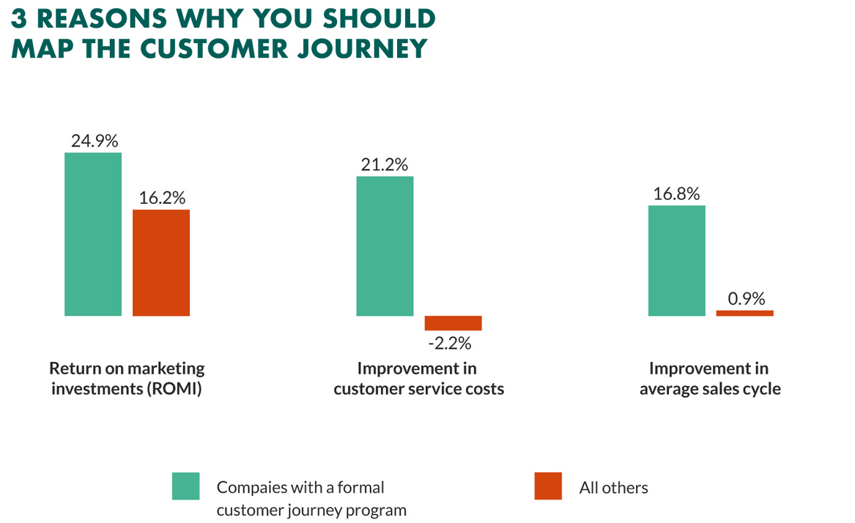
Executive Summary
Three (3) out of five (5) customers are more likely to buy from a company that has personalized their experience.
“Performance indicators are the basis for determining where advertising budget should be invested.. Data Scientists employ data mining techniques to identify the combination of channels that produces the best Return on Investments (ROI). Additionally, data scientists decide which budgets should be allotted to each channel for you to maximize your revenue WITHOUT WASTING MONEY.”

Slide 4

Campaign Budget Optimization
Every business should have a marketing strategy:
Marketing results don’t just happen by chance. Creating a strategy ensures you’re targeting the right people, with relevant content that appeals to them.
“86% of customers are willing to spend more on products for a great customer experience” – How much can we gain by providing the customer’s immediate needs.

Slide 5

Product Recommendation Engine
A product recommendation engine is a technology that uses machine learning and artificial intelligence (AI) to generate product suggestions and predictive offers, such as special deals and discounts, tailored to each customer.
The aim is to stimulate demand and actively engage users.
Not every lead becomes a customer. However, if a marketer can accurately categorize customers according to their interests, many leads will result in customers and serve as examples for predicting customer conversion.

Slide 6
A science of a combination
Previously mentioned, both campaign budget optimization and product recommendation have a part to play in the marketer’s toolkit.
They serve to maximize the ROI for advertising and increase conversions in the modern retail space.
Our customers come first, to attract and retain them our highest priority should be personalization.
Let us explore the data science of marketing from the dashboard created.
Customer Segmentation
Product Recommendation
Marketing
Conversion

Slide 7
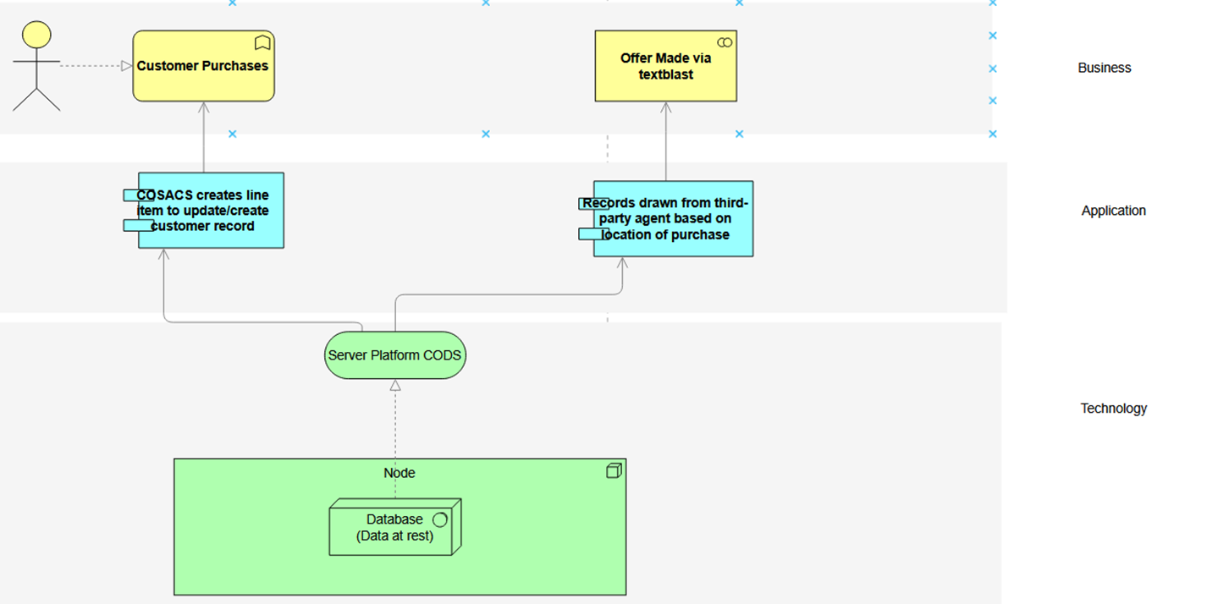
Present text blast marketing strategy
Third party determines sample based on location of last purchase.

Slide 8
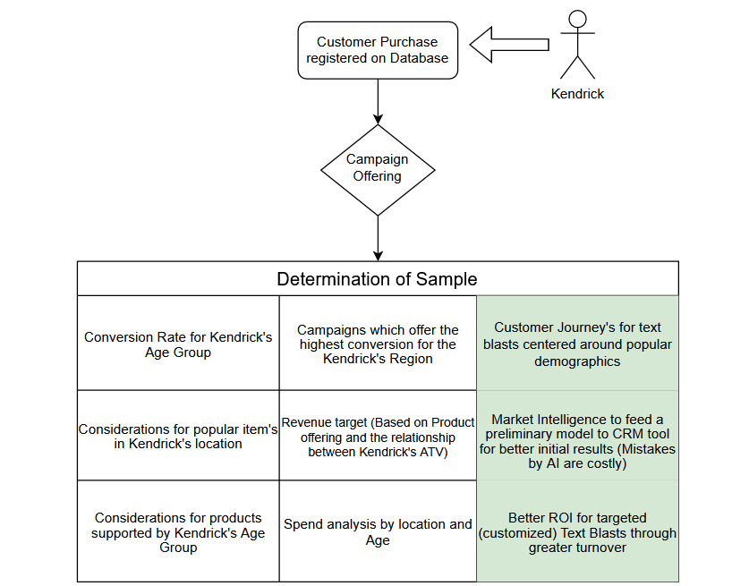
Customer Journey Mapping
Ideal situation to create a customer journey from customer data.
How to target for maximum efficiency?

Slide 9
Cash Loan

Slide 10
Modern Portfolio Theory
The fundamental goal of portfolio theory is to allocate investments (assests) between different assets (think returns on different risk weighted loans).
The tool used for optimizing the results of a portfolio of assets is mean-variance optimization.
Here we will consider the conventional single period MVO which maximized the expected return based on a selected level of risk.
Development for a multi-period MVO will be concerned with strategies in which the portfolio is rebalanced to a specified allocation at the end of each period. The Constant Proportion (CP), or Constant Ratio Asset Allocation (CRAAL) has the goal to maximize the true multi-period (geometric mean) return for a selected level of risk.

Slide 11
Conventional MVO
Key steps to a successful MVO:
Define your product set (here we have the different rates available to customers based on their assessed risk-level).
Determine your budget (here we are considering the portfolio weight of each asset class).
Calculate expected returns and risks
Build a covariance matrix
Define the objective function: In mean-variance analysis, the objective is to maximize the portfolio return while minimizing the portfolio risk. Create an objective function that combines the expected returns and risks of the products using weights.
Determine constraints: Establish any constraints you have, such as the budget constraint, which specifies that the sum of the allocated amounts cannot exceed the total budget. You may also set constraints on minimum or maximum allocation percentages for individual products.

Slide 12
Conventional MVO (cont’d)
Solve the optimization problem: Use a mathematical optimization technique such as quadratic programming or linear programming to solve the mean-variance optimization problem. These techniques will help you find the optimal allocation that maximizes the portfolio return while minimizing the portfolio risk, subject to the defined constraints.
Caveat:
Remember that mean-variance analysis provides a framework for decision-making, but it relies heavily on the accuracy and reliability of input data. Additionally, it assumes that returns and risks are normally distributed and that historical patterns will repeat in the future, which may not always be the case. Therefore, it's important to exercise judgment and consider additional factors when making allocation decisions.

Slide 13
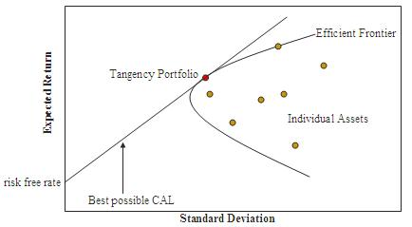
The output from MVO
*CAL: Capital Allocation Line i.e reward-to-variability ratio

Slide 14
The completion of the second leg of this project will require a combined effort between Regional Operations and Regional Credit to find inputs to the model. We also require a subspace on the Cloud Platform for Caribbean data else the models developed could have some bias associated with external elements.

